Slide 1
IBM University Engagement Project Submission
“Exploring the Power of Agentic AI with IBM Cloud and Orchestrate”
FinanceGuru — AI Agent for Digital Financial Literacy
Presented by Anurag Singh | anusinghz926@gmail.com | 9798869904

Slide 2

Project Title – FinanceGuru: AI Agent for Digital Financial Literacy
Domain of Project – Finance / Digital Financial Literacy / Agentic AI
Student Name | Recent Passport Photo | Email ID | Mobile number [WhatsApp]
Anurag Singh |  | anusinghz926@gmail.com | 9798869904
Recommended format followed: Font Style: Arial
Heading: 28 pt | Content: 20 pt

Slide 3
Problem Statement – No. 7: AI Agent for Digital Financial Literacy
The Challenge
Users need simple, trustworthy guidance for UPI, online scams, interest rates, budgeting and personal finance.
Reliable information is spread across government portals, banking websites and educational platforms.
Many users need multilingual support to ask financial questions comfortably.
Objective
Build an AI-powered Digital Financial Literacy Agent that retrieves reliable financial content, explains it in simple language, detects scam risks, and improves confidence in digital finance.
Target impact: safer digital payments, better financial understanding, and faster fraud-response guidance.

Slide 4
Proposed Solution – FinanceGuru Digital Financial Literacy Agent
FinanceGuru is a conversational AI assistant designed for Indian users and delivered through a browser-based chat interface.
IBM watsonx Orchestrate provides the agent runtime and reasoning workflow.
Covers 9 finance areas: FDs, stocks, mutual funds, crypto, UPI safety, loans, budgeting, PPF/NPS/gold and cyber-fraud reporting.
Proactive scam detection identifies red flags such as urgency, OTP/PIN requests, guaranteed returns and suspicious loan fees.
Direct answers include EMI / maturity calculations and plain-language explanations.
Hindi/English interaction improves accessibility.
Flask connects the browser UI to the watsonx Orchestrate Chat Completions API; Web Speech API enables voice input.
Current build note: financial knowledge is embedded in the agent instruction set; a future RAG layer can connect curated official sources.

Slide 5
Technology Used
IBM watsonx Orchestrate – Native agent runtime and conversational orchestration.
IBM Granite – Required IBM AI model family for the AICTE problem statement; Granite configurations are included in the project artifacts.
Current Orchestrate build – Screenshot shows GPT-OSS 120B via Groq as the active model configuration.
Python + Flask – Web backend, API mediation, session/thread management.
IBM IAM – Converts the server-side API key into a short-lived Bearer token.
Chat Completions API – Sends user messages to the Orchestrate agent and receives responses.
HTML / CSS / JavaScript – Responsive chat interface, markdown rendering and dark/light mode.
Web Speech API – Client-side voice-to-text input (en-IN in the current implementation).
9. RAG-ready architecture – Curated official sources can be connected for grounded retrieval in the next iteration.

Slide 6

Orchestrate Components Used
1. Chat Input
User enters a finance question by text; voice input can populate the chat box.
2. IBM watsonx AI Agent
Core FinanceGuru agent reasons over the query and produces a direct answer.
3. Model Layer
Current build screenshot: GPT-OSS 120B via Groq; Granite configurations are present in project artifacts.
4. Chat Output
Displays financial explanations, calculations, scam warnings and next steps.
5. Session / Thread
Flask stores the Orchestrate thread_id so the conversation can continue with context.
6. Voice Input
Browser Web Speech API converts spoken input into text.

Slide 7
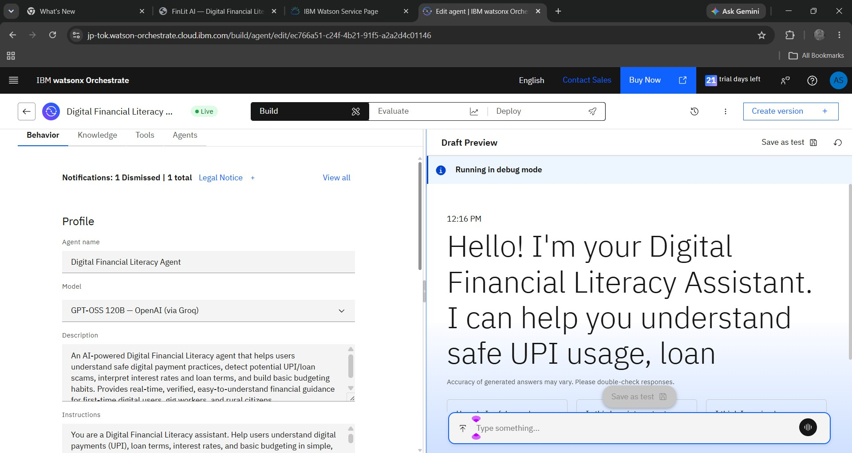
Demo Screenshot 1 – IBM watsonx Orchestrate Agent Configuration

Slide 8
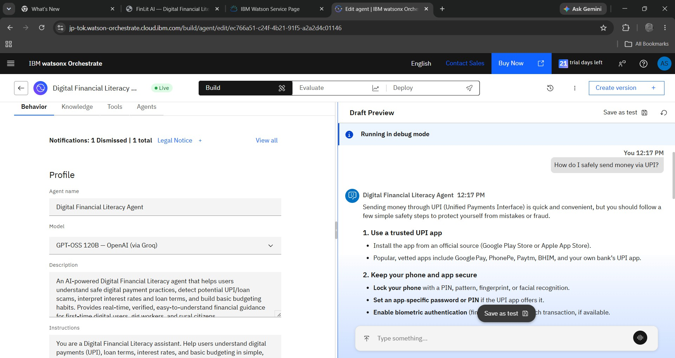
Demo Screenshot 2 – UPI Safety Response
Prompt: “How do I safely send money via UPI?”

Slide 9
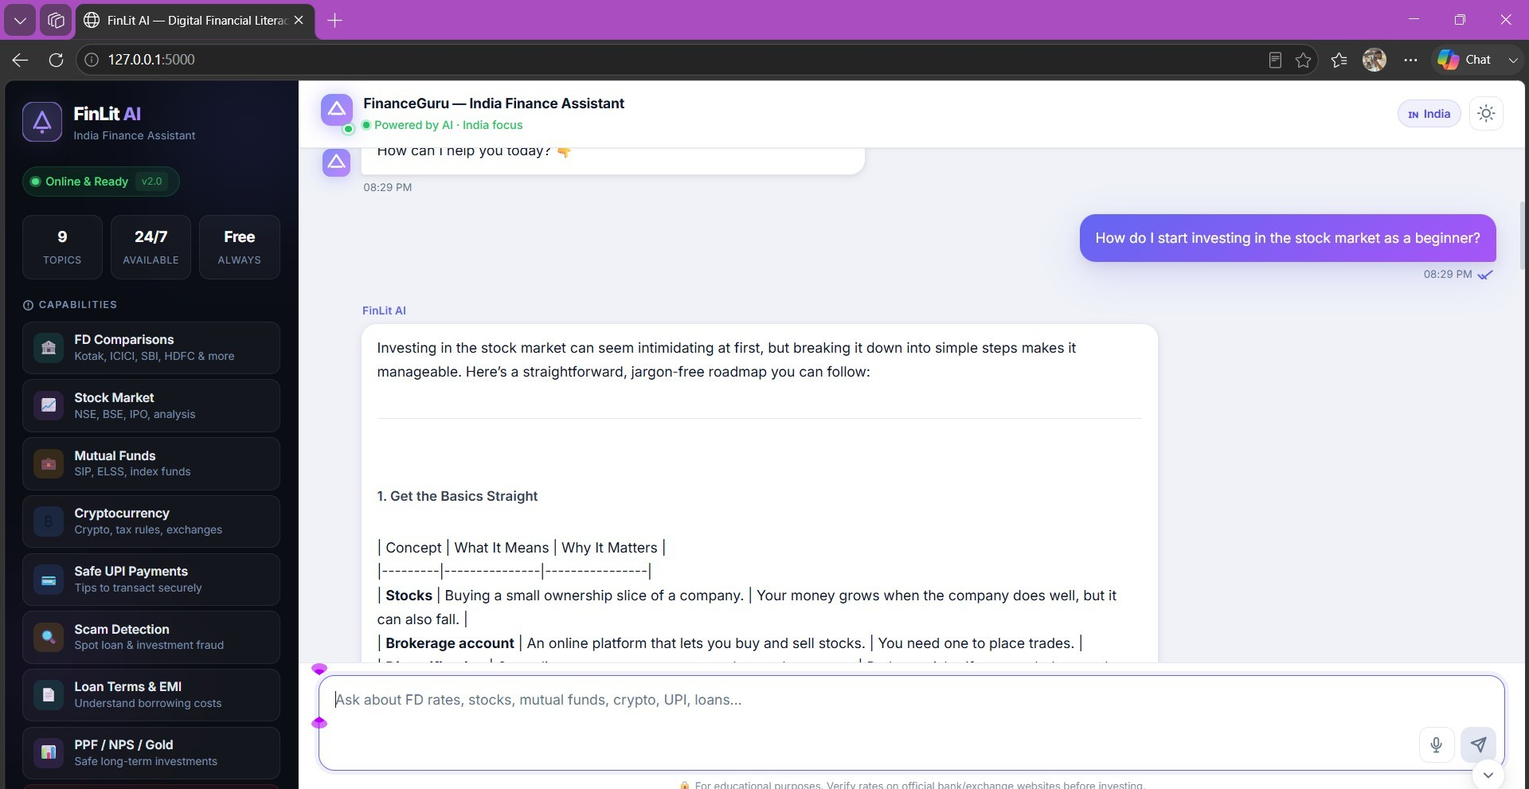
Demo Screenshot 3 – FinanceGuru Web App Stock-Market Demo
Example prompt: “How do I start investing in the stock market as a
beginner?”
Demo flow: user question → FinanceGuru reasoning → financial guidance / safety response

Slide 10
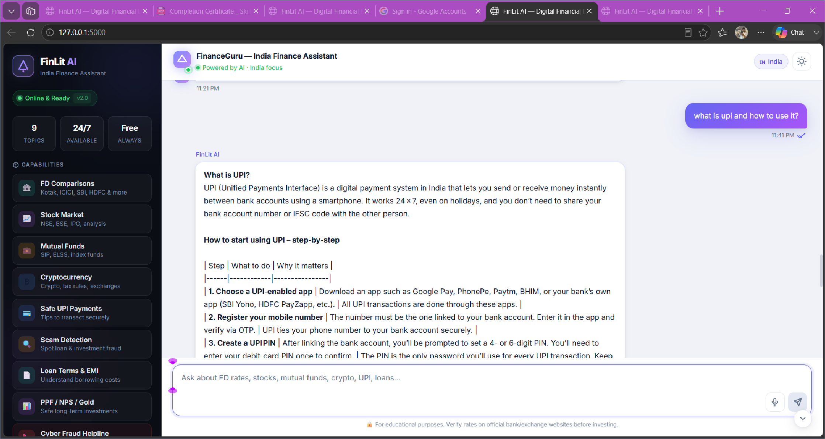
FinanceGuru Web App · UPI Guidance Demo

Slide 11
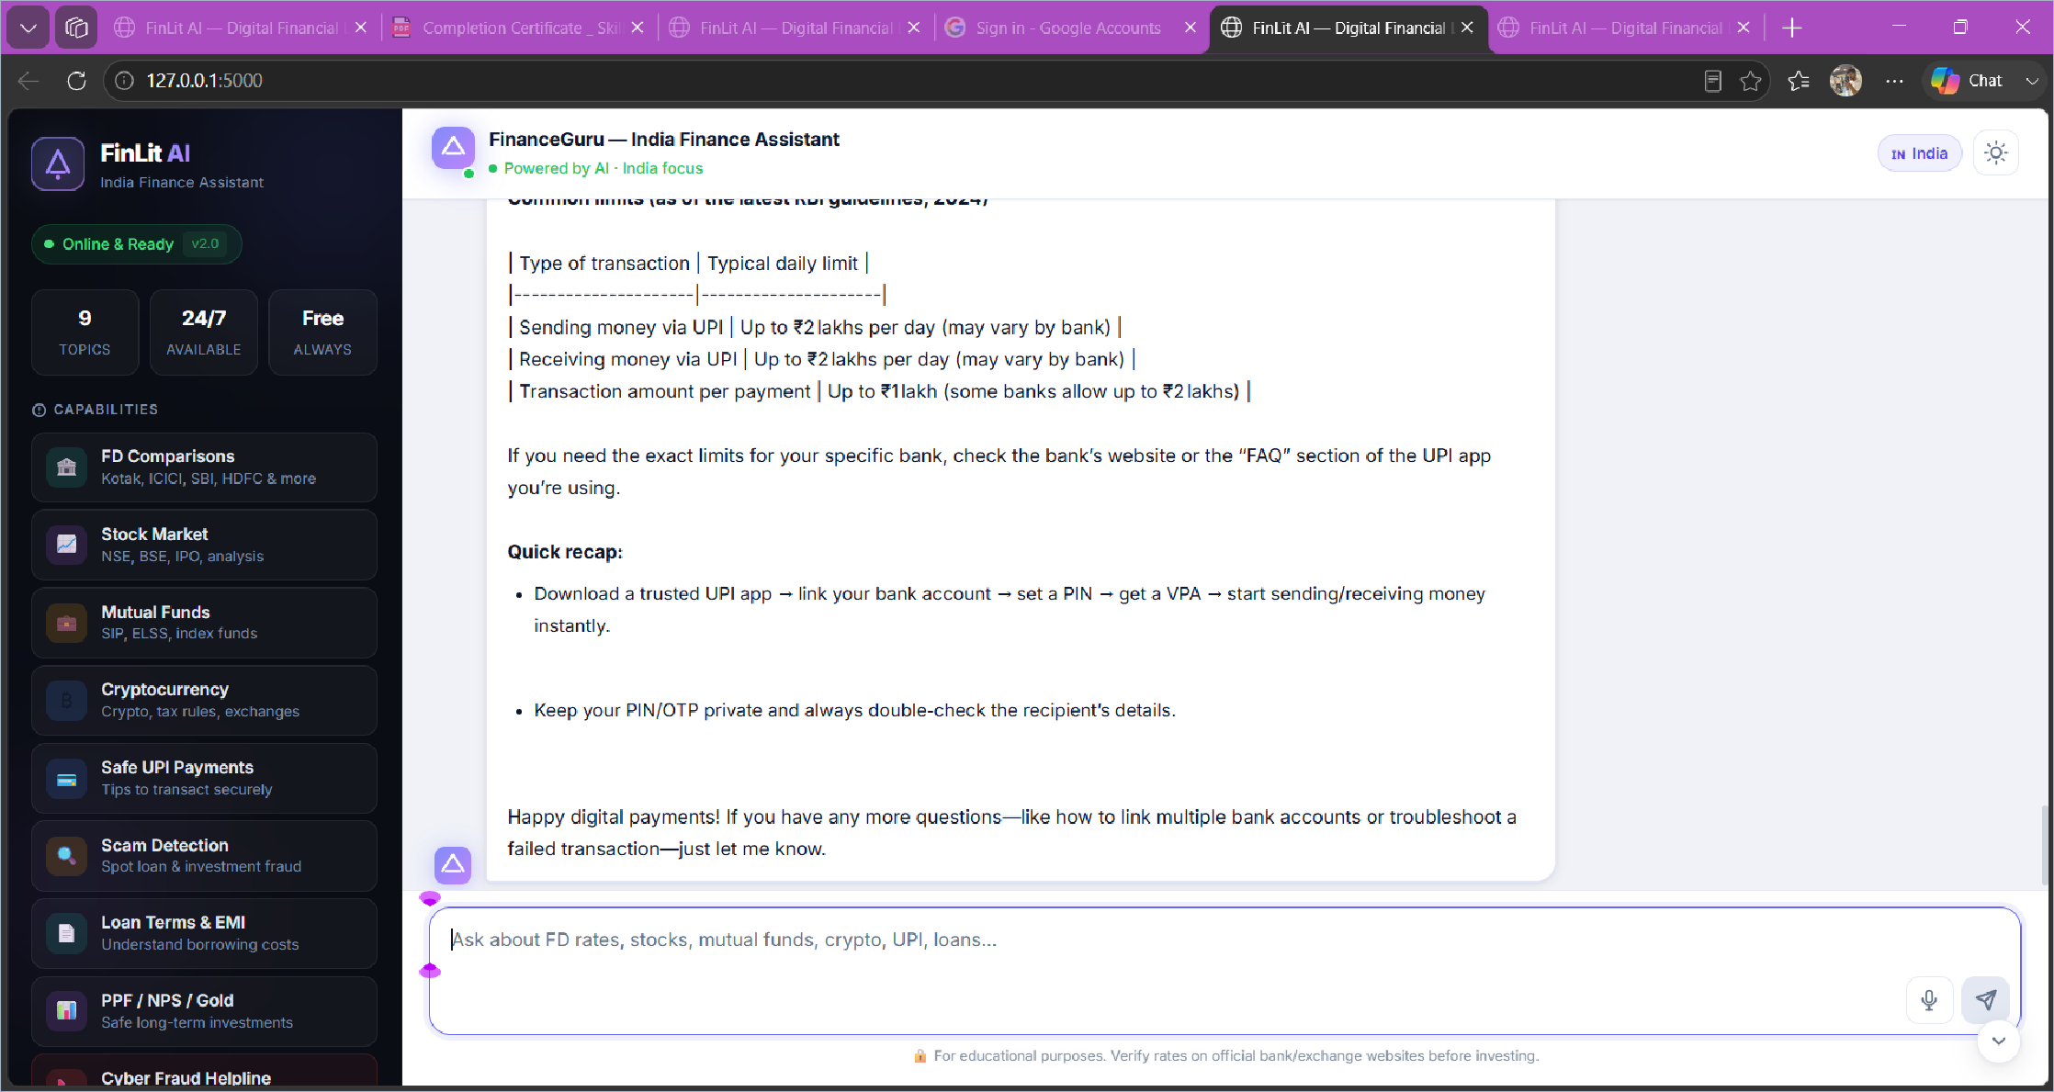
FinanceGuru Web App · UPI Limits & Safety Guidance

Slide 12
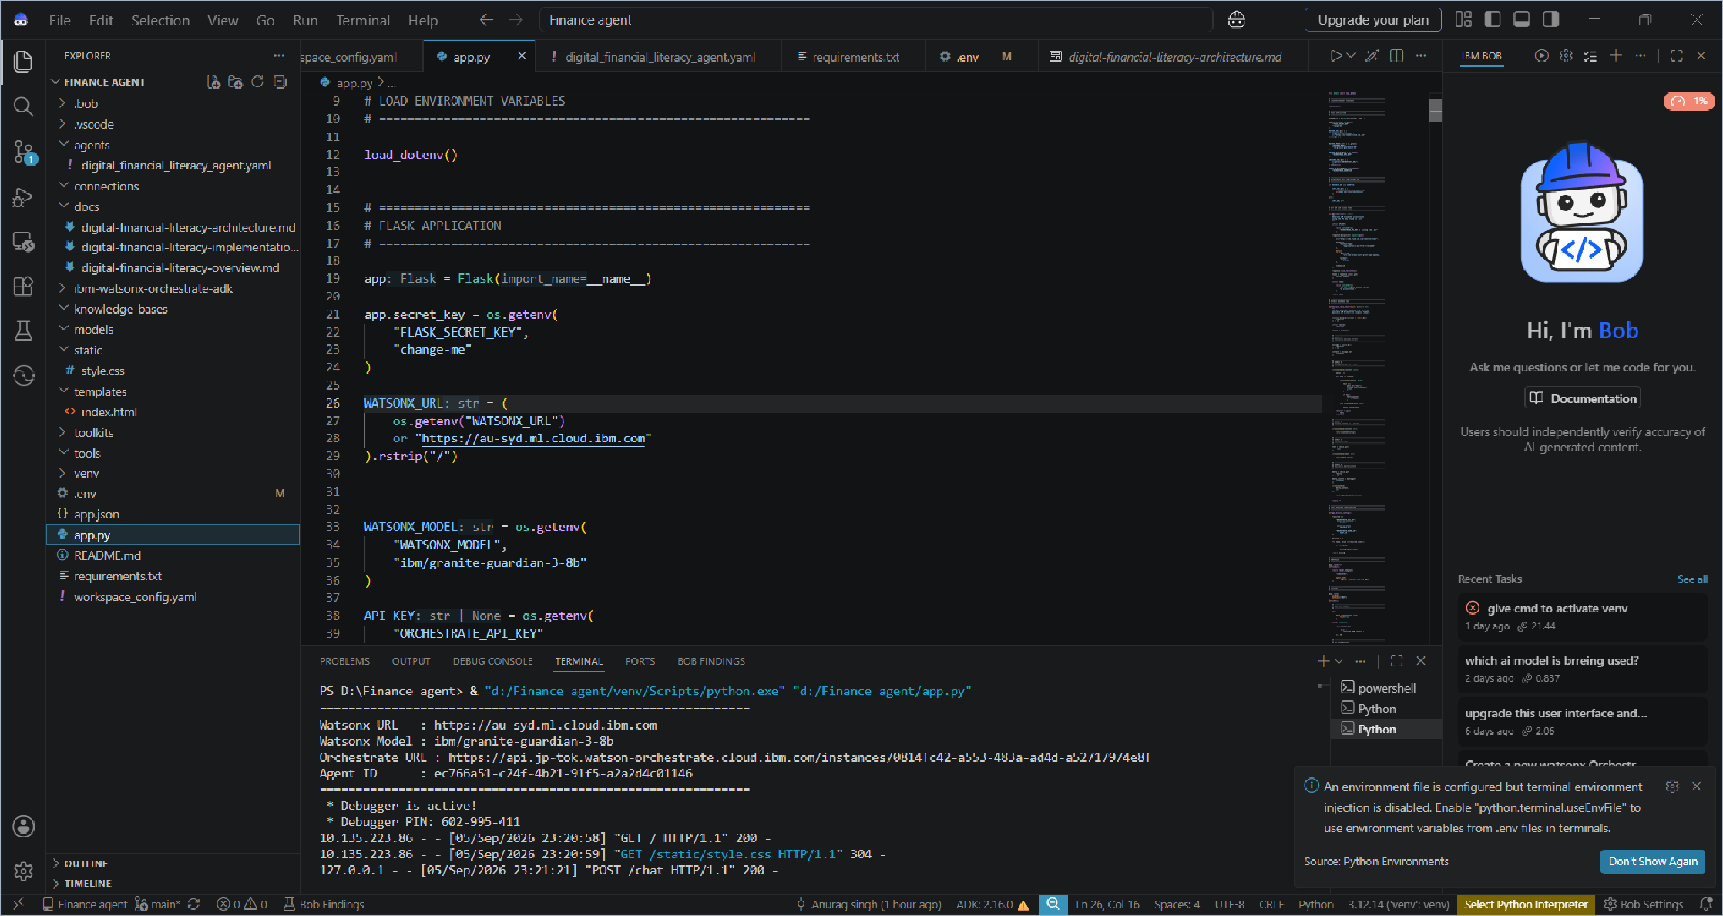
Project Code & Watsonx Configuration

Slide 13
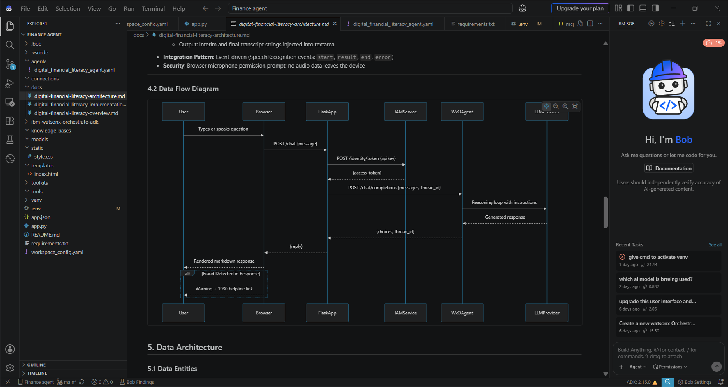
FinanceGuru Architecture / Data Flow

Slide 14
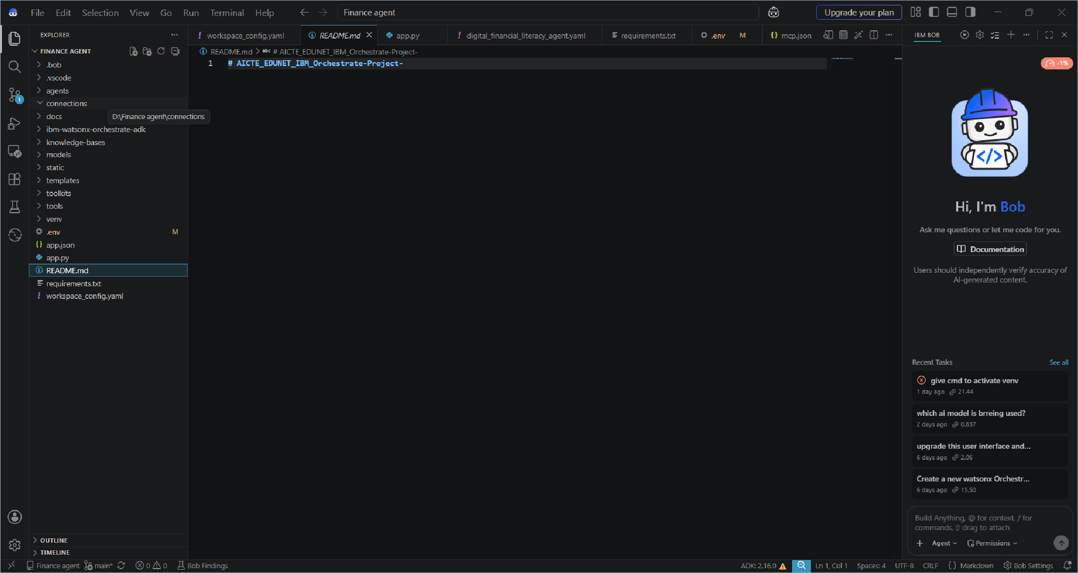
GitHub Repository / README

Slide 15


“ Dor I
F\nar
anusi
wa Isr
jp tok.watson orchest rate cloud.ibm com/buiId/ag ent s/anal
ics/ec766a 51 c24f 4b21 91f5 a2a2d4c01146*Iim eRa nge= past 24 hours
TBM wateonx Orcheetrate
English
Home / Analytics / Digital Financial Literacy Agent
Digital Financial Literacy Agent
Overview Conversations
Last 24 hrs v
Total conversations
7
Input token count
25.3k
Output token count
10.7k
Unique users
2
Avg conversation duration
52s
Avg message latency
6.2s
Usage trend
User feedback
Evaluation
Preview
Toxicity v
Total messages : 9
1
6
0
messages
Thumbs up
4
Thumbs down
# 3

Slide 16

Role of Agentic AI in the Solution
Agentic AI makes FinanceGuru more than a static FAQ chatbot.
USER
↓ UNDERSTAND
↓ REASON
↓
DETECT RISK
↓ RESPOND
↓
ESCALATE / VERIFY
Goal-driven reasoning – decomposes finance questions before answering.
Context awareness – uses the current conversation and user-provided details.
Proactive action – detects scam patterns and leads users toward official reporting channels.
Decision support – compares options and performs EMI / FD maturity calculations.
Adaptive conversation – keeps context using Orchestrate thread IDs.
Human-centered delivery – explains financial concepts in simple language and supports Hindi/English interaction.
Result: a proactive, personalized financial education assistant focused on safer digital finance.

Slide 17
Novelty and Uniqueness
FinanceGuru differentiates itself by combining financial education, scam awareness and agentic reasoning in one assistant.
Unified finance assistant – one interface for UPI, loans, investments, budgeting and fraud.
Proactive scam radar – warns about suspicious patterns before users act.
Direct calculations – explains EMI and FD maturity instead of redirecting users to a calculator.
Plain-language design – financial jargon is explained for beginners.
Bilingual interaction – designed for Hindi and English queries.
Voice-enabled access – browser speech input reduces typing friction.
Official-channel escalation – 1930 and cybercrime.gov.in are surfaced for live fraud cases.
RAG-ready – can evolve from embedded instructions to retrieval from curated official sources.

Slide 18
Public repository URL
https://github.com/anusinghz926-ai/AICTE_EDUNET_IBM_Orchestrate-Project-
Repository contents
app.py • app.json • agents/digital_financial_literacy_agent.yaml docs/architecture • docs/implementation • docs/overview • README.md
Submission note
The public repository contains the FinanceGuru application, agent configuration and project documentation.

Slide 19
Future Scope
RAG with trusted live sources
Connect curated RBI, SEBI, NPCI, government and banking sources so rates/rules can be retrieved and cited more dynamically.
Hindi-first & multilingual voice
Extend Web Speech API language selection and support more Indian languages for rural and semi-urban users.
Live financial data connectors
Add controlled data feeds for current FD rates, market information and official policy updates.
Personal finance dashboard
Track budgets, savings goals and learning progress without storing unnecessary personal data.
Stronger deployment security
Remove debug response logging, use production-grade session storage and strengthen secrets management before scale-out.

Slide 20

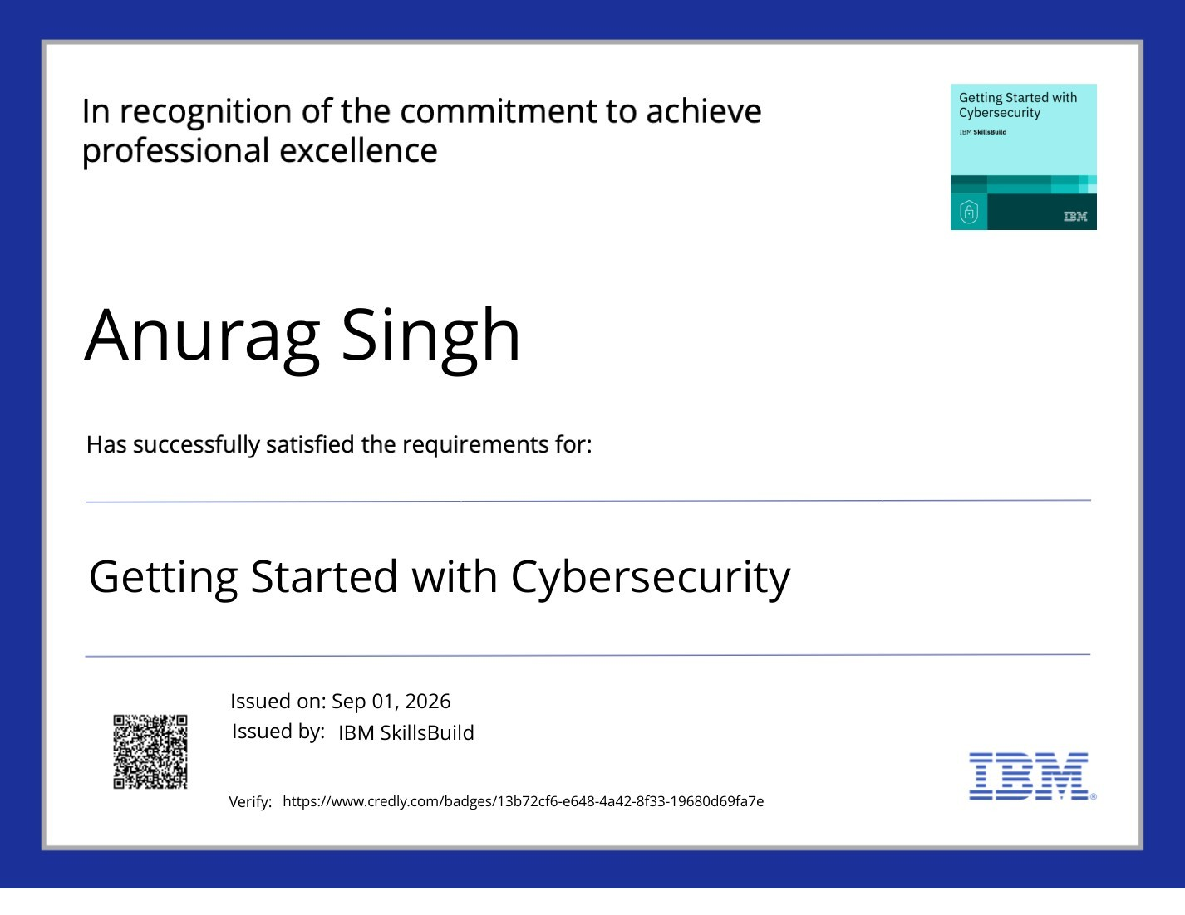

Certificates & IBM SkillsBuild Credentials • 1
Getting Started with Cybersecurity
Getting Started with Artificial Intelligence

Slide 21

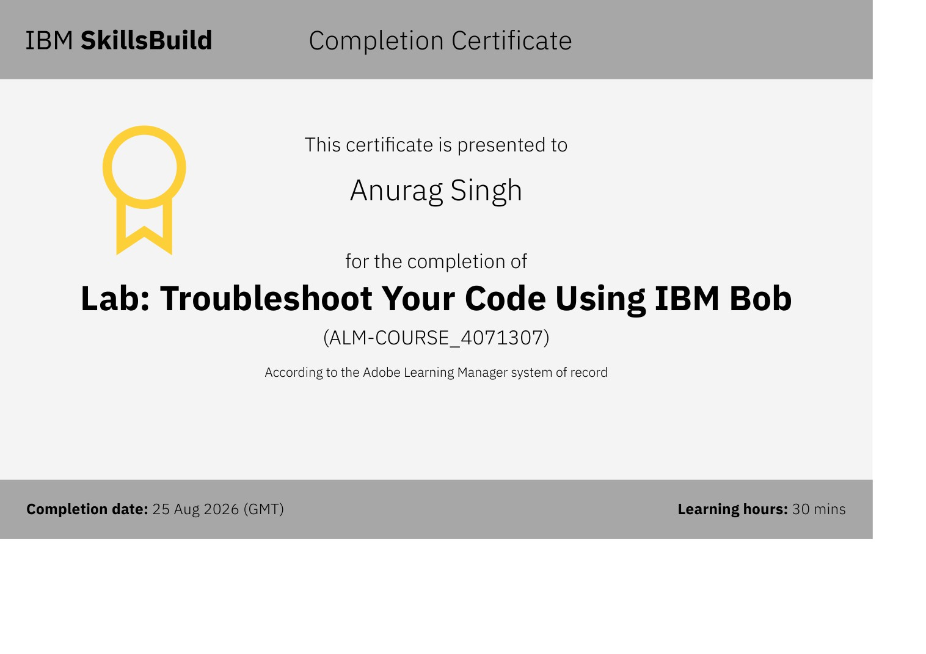
Certificates & IBM SkillsBuild Credentials • 2
Lab: Troubleshoot Your Code Using IBM Bob

Slide 22
THANK YOU
FinanceGuru — AI Agent for Digital Financial Literacy
Anurag Singh | anusinghz926@gmail.com | 9798869904

